Slide 1
Neighborhood-based analysis of manifold embeddings and self-organizing maps
Tyler J Burns, Ph.D.
AG Mei at German Rheumatism Research Center

Slide 2
Outline
About me
Part 1: Interrogating the fidelity of a t-SNE map
Part 2: Exploring the visual capabilities of large self-organizing maps

Slide 3
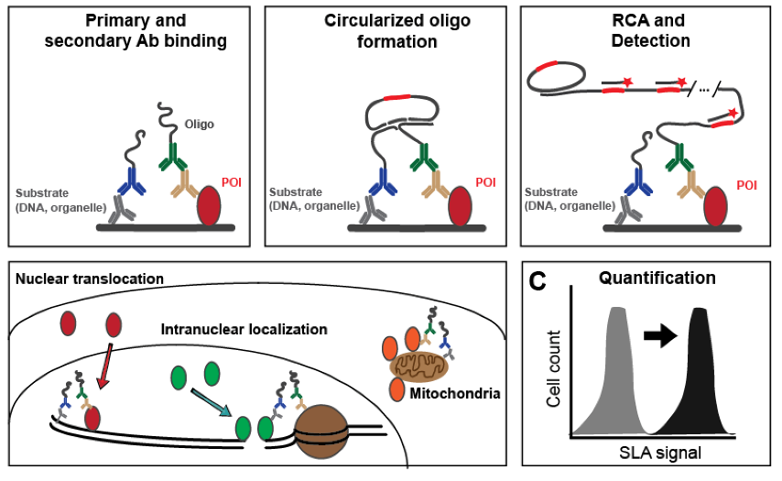
I am a classical biologist by training
Burns et al, Cytometry 2017

Slide 4
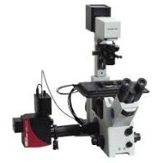
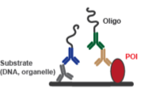
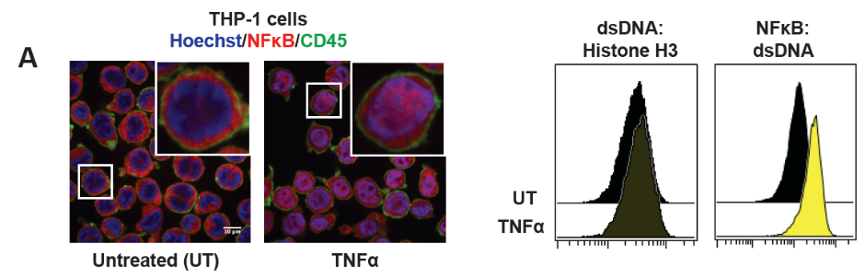
I am a classical biologist by training
Confocal microscopy
SLA with flow cytometry

Slide 5
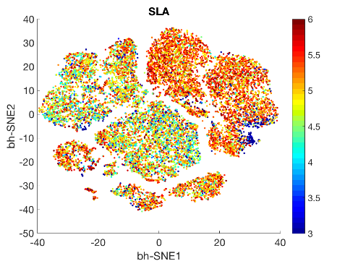
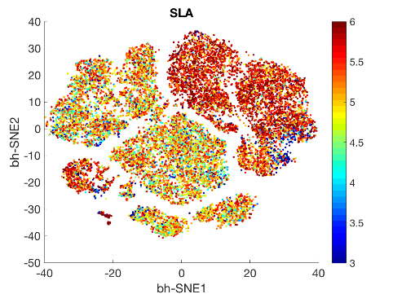
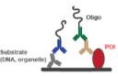
But I ran into a computational problem…
Untreated
TNFα, 30min
Color:
Nuclear NF-kB
Color:
Nuclear NF-kB

Slide 6
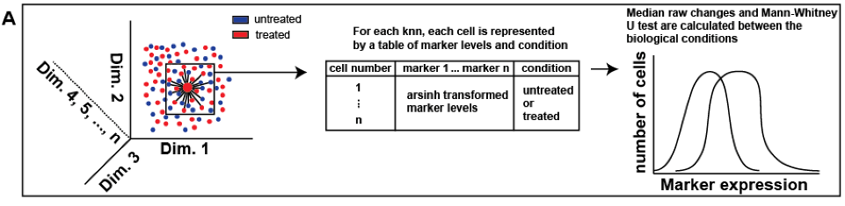
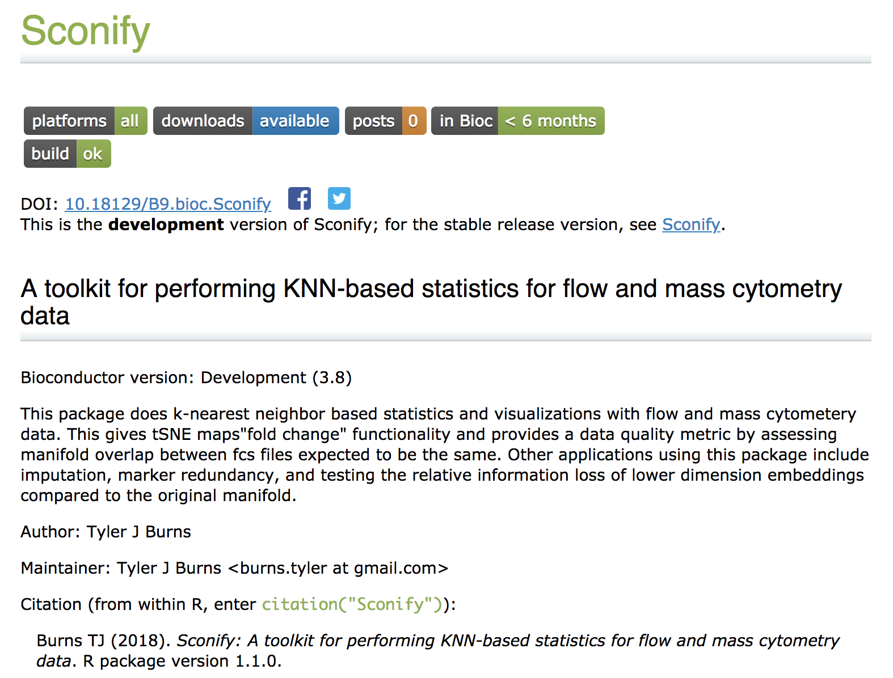
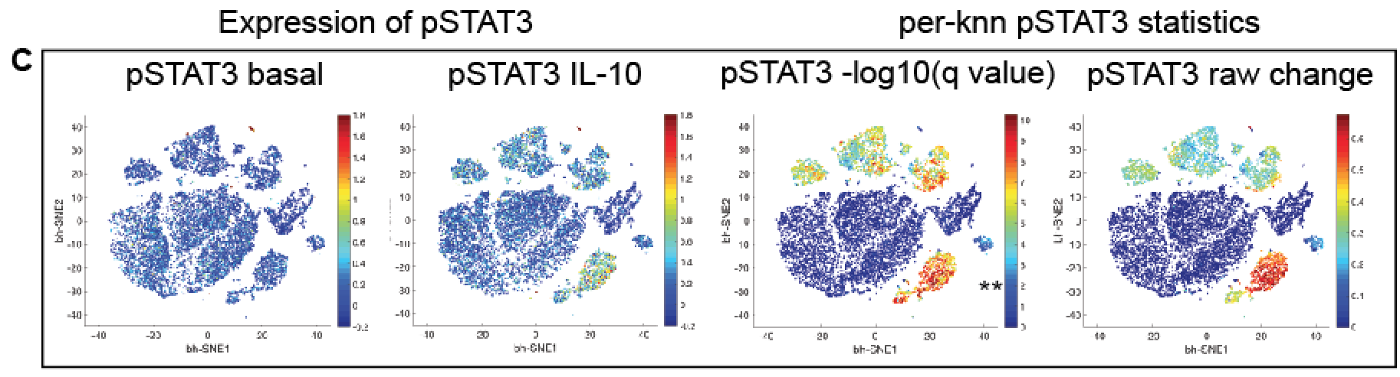
That I solved by developing some software
Burns et al, BiorXiv
2018

Slide 7

Part 1: Interrogating the fidelity of a t-SNE map

Slide 8
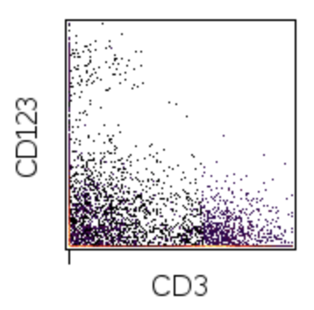
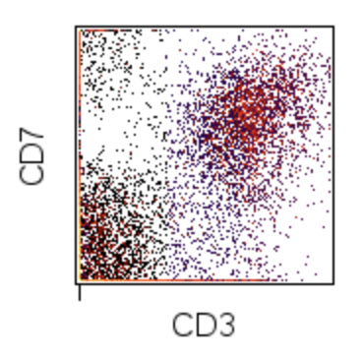
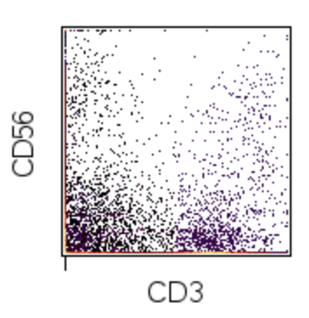
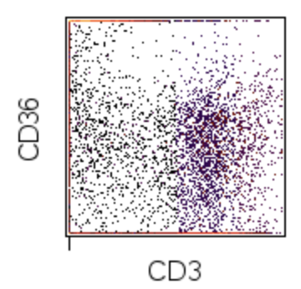
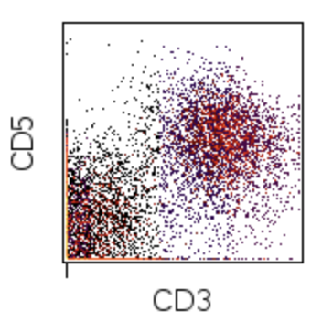
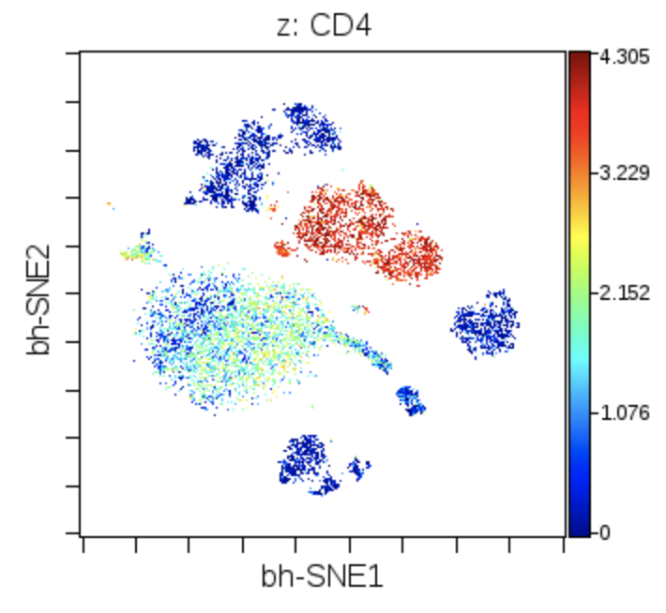
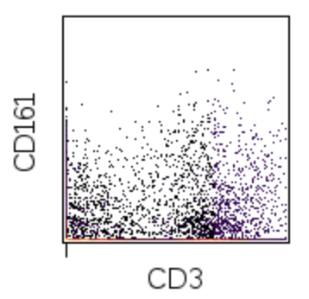
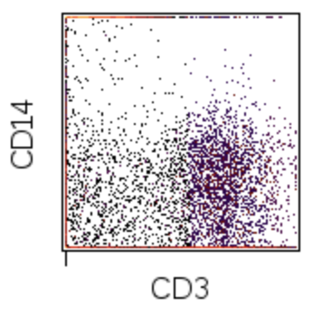
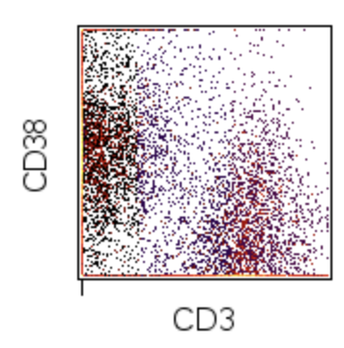
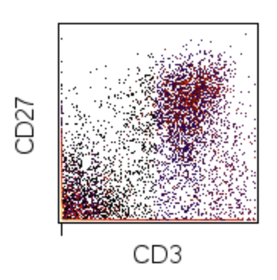
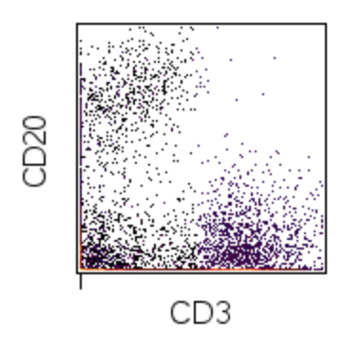
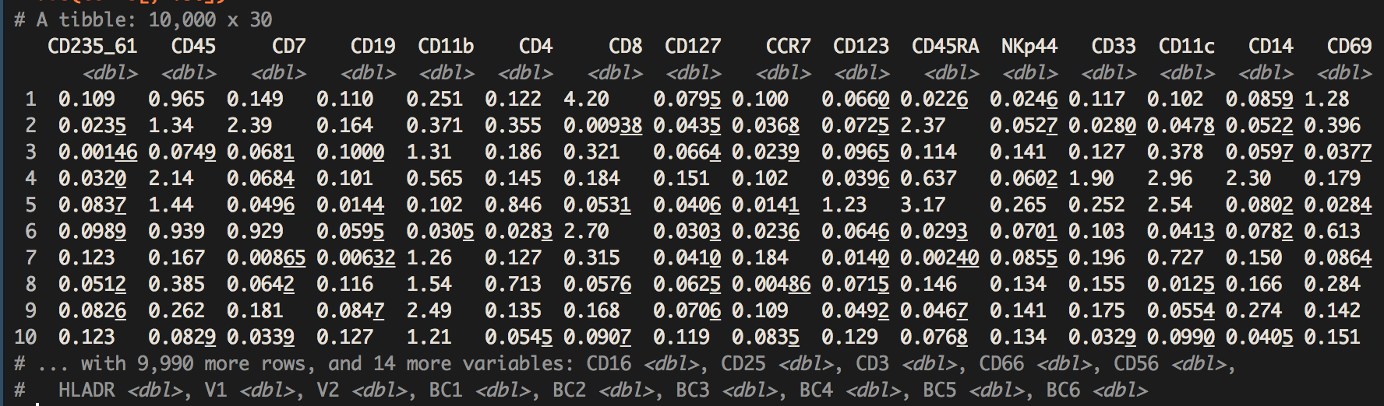
t-SNE makes large amounts of information human-palatable without too much human work
t-SNE(cells)
Amir et al, Nat Biotechnology 2013
Notes:
t-SNE is a popular algorithm that does this task. It takes otherwise really complicated data, which we would otherwise see as lots of biaxial plots or a really big ugly excel sheet, and turns it into a spatial map where cells that are similar to each other in high dimensional space are near each other in low dimensional space.

Slide 9
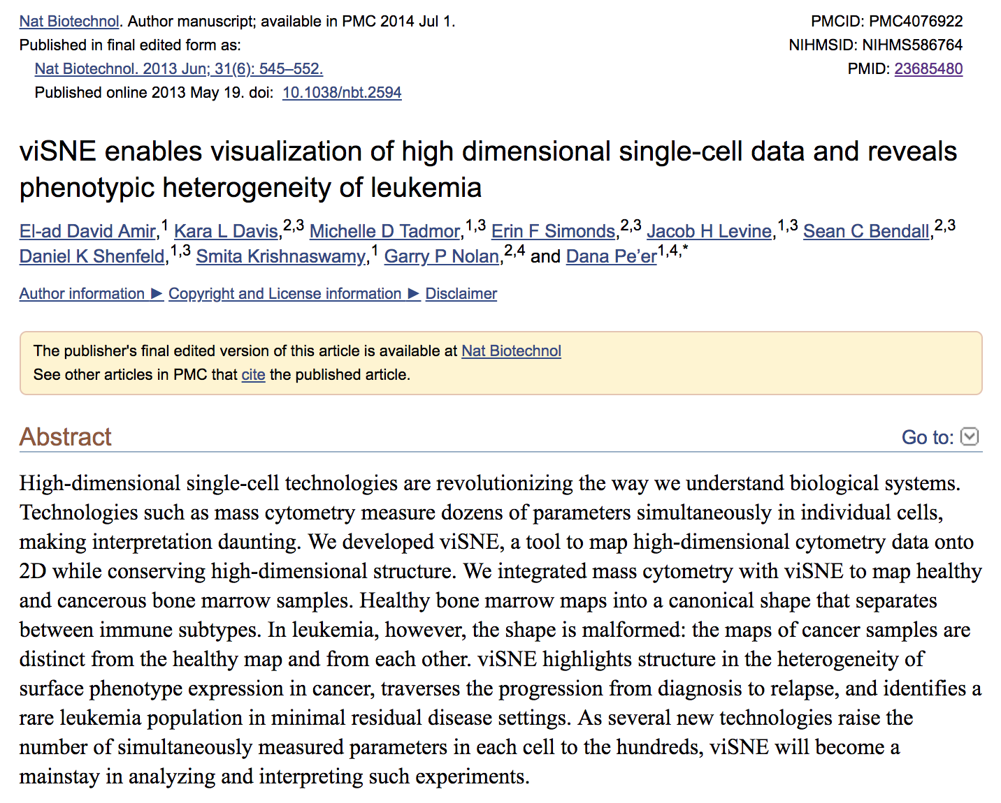
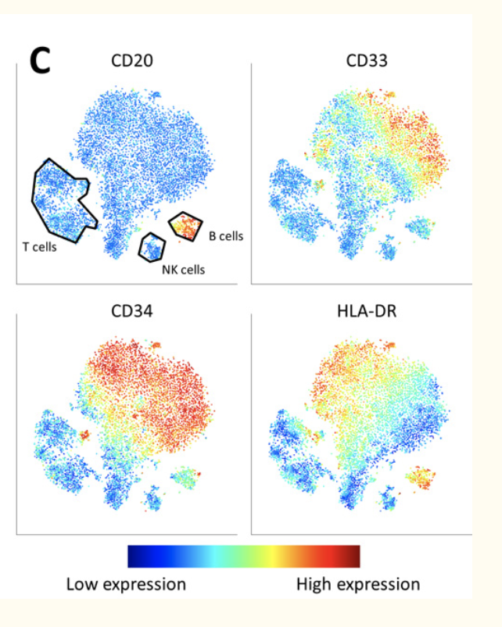
viSNE: the adaptation of t-SNE to CyTOF
Notes:
So t-SNE was applied to mass cytometry in 2013 by El-ad David Amir, where the name was changed to viSNE….but it’s just t-SNE. Now El-ad is a friend of mine. What I can tell you is that it wasn’t him who insisted on the name change, it was Dana Pe’er. Regardless, I have lots of respect to both of them for having the acumen to connect t-SNE to CyTOF. It has since taken off in both CyTOF analysis and some of the more recent methods, like single cell sequencing.

Slide 10
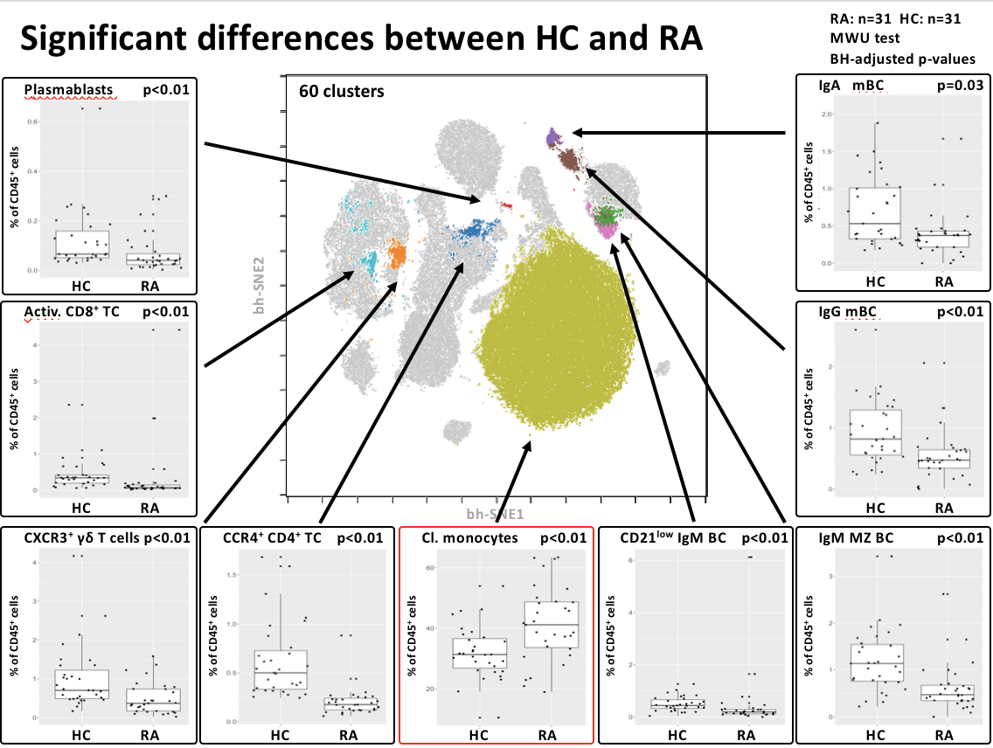
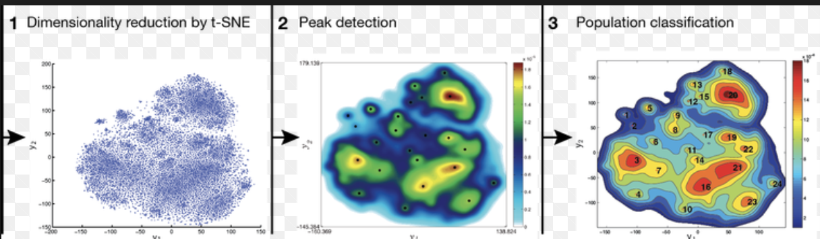
Two main uses of t-SNE
Example: Axel Schulz, AG Mei
Data visualization tool
Early phases: gain intuition about data
Late phases: summarize statistical output
Part of a data analysis pipeline
Gating a t-SNE map
Clustering a t-SNE map
Example: ACCENSE
Notes:
So there are two main uses of t-SNE that I’m going to go over. The first is the way it’s used in AG-Mei, as a visualization tool. You can make nice summaries of complicated results through these maps if you know what you’re doing.
The second is actually part of the data analysis pipeline. In particular gating and clustering the t-SNE map. This has generated a lot of debate, so it needs to be addressed in a data-driven manner.

Slide 11
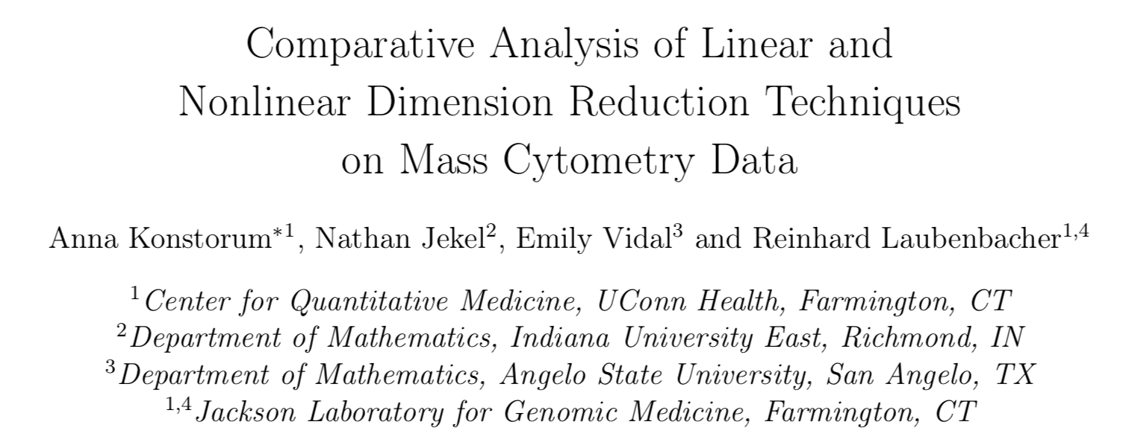
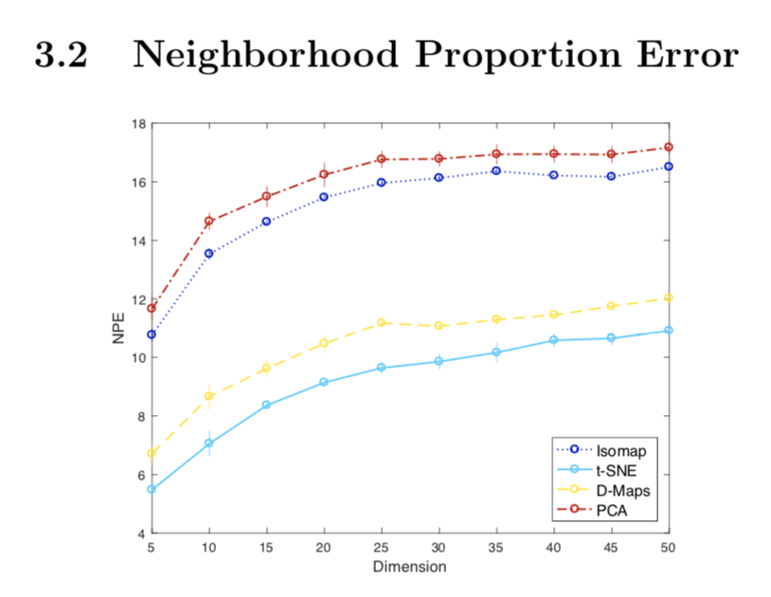
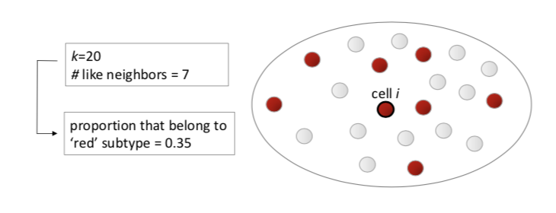
Low-dimension fidelity has been only recently addressed for single cell data
This is based on manual gating,
like the F1 Score for Clustering
Notes:
This is a topic that has only recently been addressed by a single paper in pre-print at BioRxiv, where the authors developed a fidelity score that looks at how manual gates group on a low-dimensional embedding, generated by one of multiple algorithms. It shows t-SNE leads the way at least in terms of this score. However, the community right now is trying to move away from manual gate-related measures because of the human bias associated with this.

Slide 12
What is still needed from Low-D fidelity analysis
Manual gating-free fidelity measure
A way to assess LOCAL fidelity rather than global fidelity
A deep-dive into a single algorithm rather than a high-level overview of multiple algorithms
A software pipeline (eg. R package) that can incorporate new algorithms as they come out AFTER the paper is out.
Notes:
So I wanted to develop a way to look at t-SNE fidelity without manual gates, and I wanted it to be intuitive. I wanted to deep dive into t-SNE, and I wanted a software pipeline I could run new low-d embeddings methods through as they come out. Be it t-SNE variances (like h-SNE) or completely different methods.

Slide 13
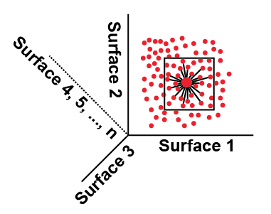
KNN without manual gating to determine fidelity of lower dimensional embeddings
KNN orig
KNN low-D
Find KNN for each cell from high-dim space
Find KNN for each cell from a 2-D embedding (eg tSNE)
Compare KNN identities from the 2-D embedding and high-dim space
Repeat across a wide range of values for K
Bioconductor package: Sconify
Notes:
So I decided simply to look at each cell’s nearest neighborhood in the high dimensional space, and see if its neighborhood on the t-SNE map is the same. Now, if only there was a publicly available peer reviewed software pipeline that would make the relevant data processing and nearest neighborhood analysis simple and efficent…

Slide 14
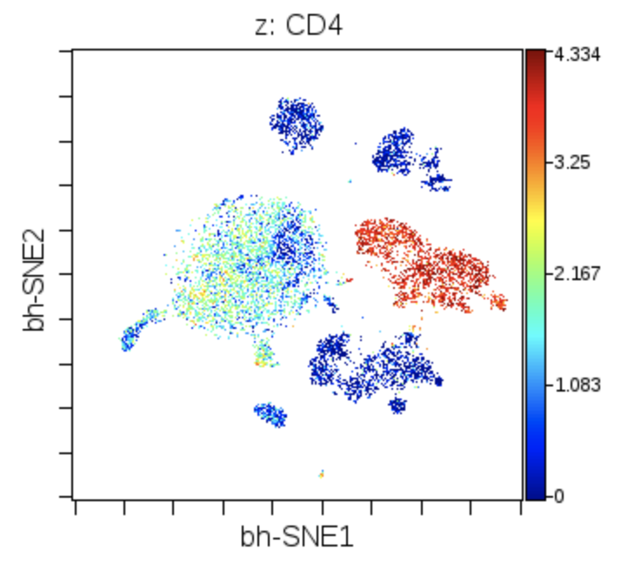
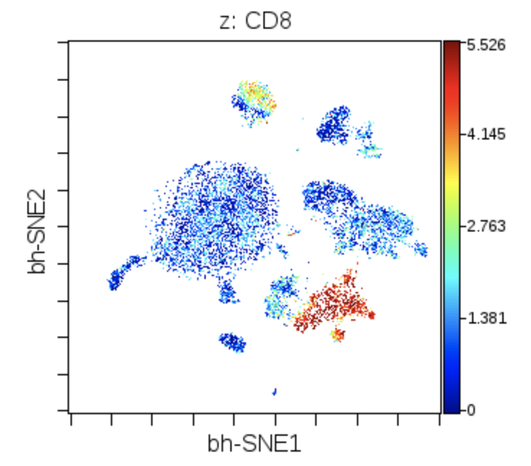
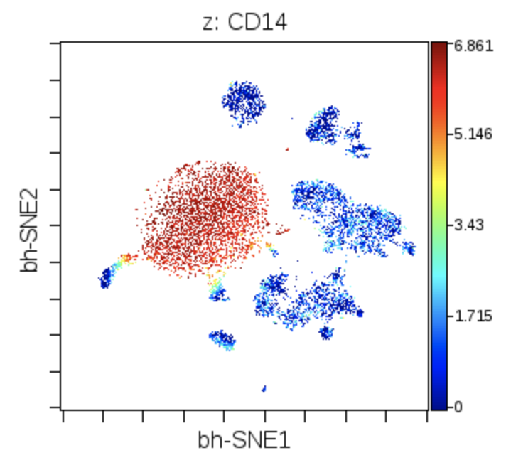
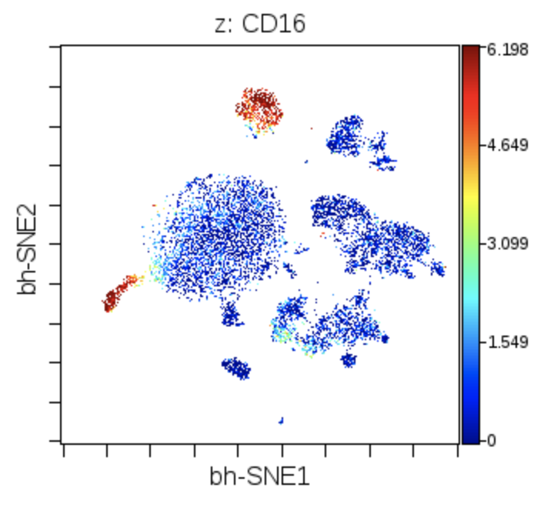
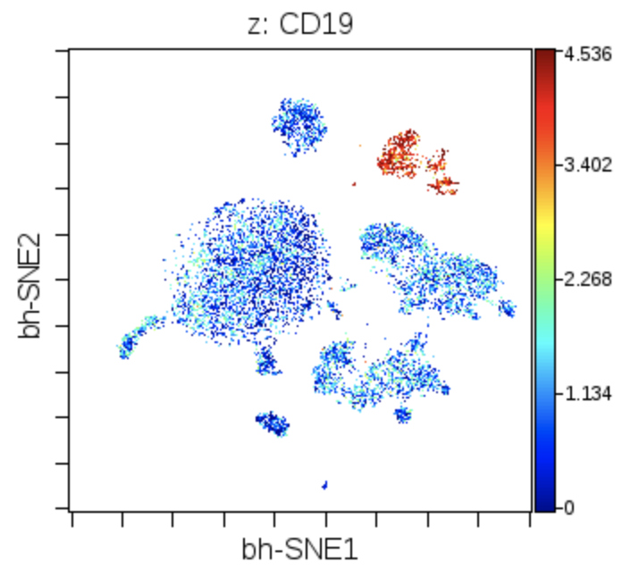
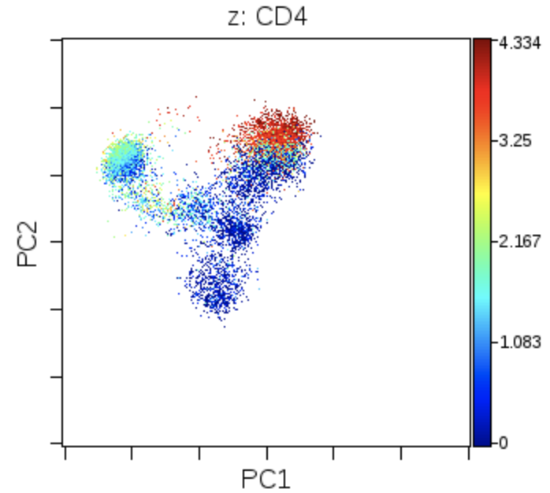
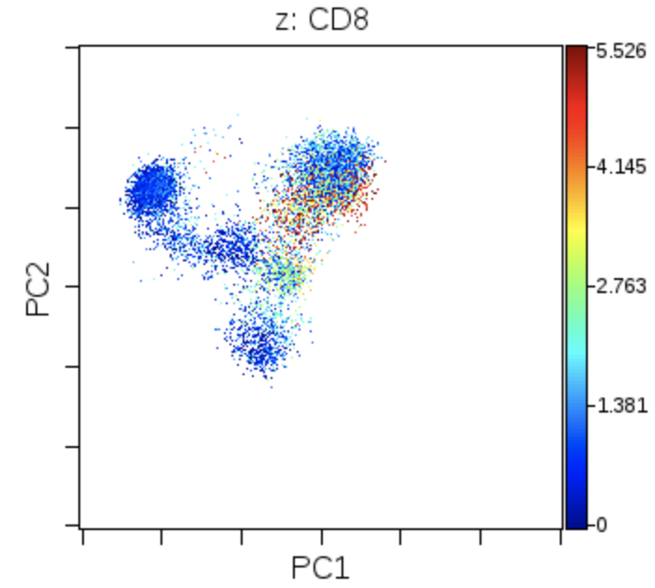
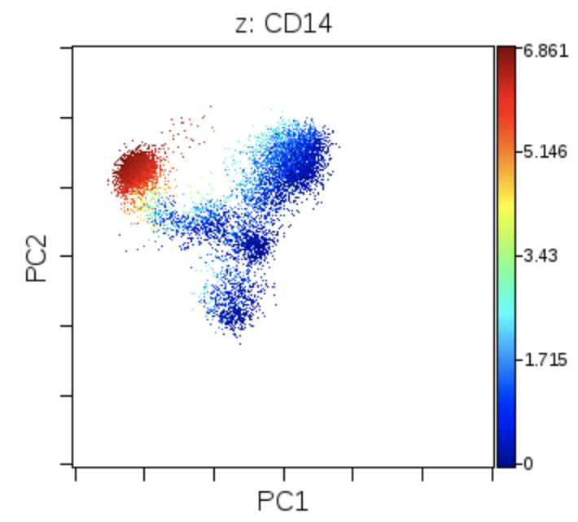
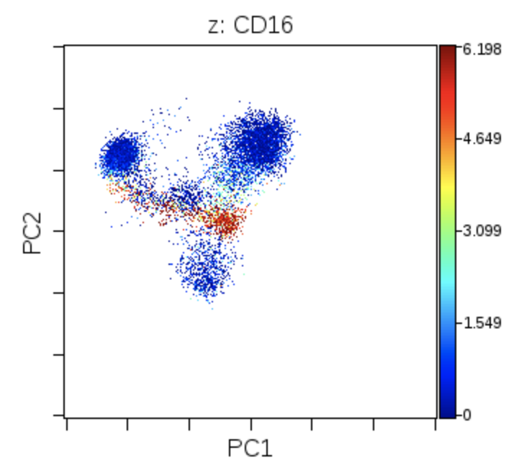
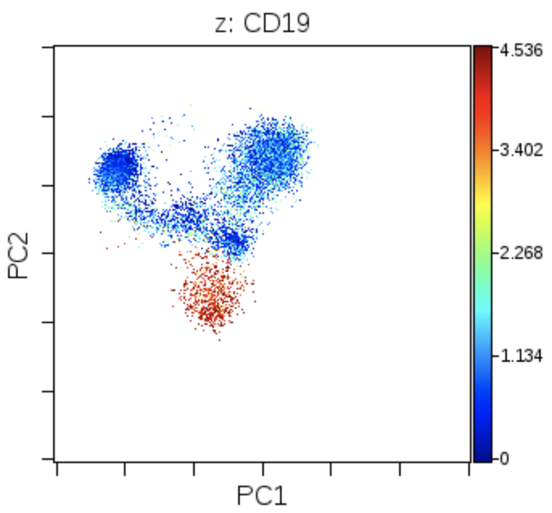
A quick review: Principal Components Analysis (PCA) vs t-SNE
t-SNE (how most people do dim reduction for CyTOF)
PCA (the old or first-pass way of dim reduction)
Notes:
So this just aims to show you that t-SNE wasn’t the first dimension reduction algorithm. There are older ones. Principal Components Analysis is shown below. I’m not going to get into how it works and what the costs and benefits are, but I hope you can see just by this visualization why the CyTOF community is using t-SNE rather than PCA for its dimension reduction visualizations.
Now pause for a minute and ask yourself on average what percent of a cell’s nearest neighbors, of, say size 20 in high-dimensional space, are shared in t-SNE space.

Slide 15

t-SNE preserves local structure at the expense of global structure
t-SNE
vs (KNN)
Local
Structure
Global
Structure
High-dimensional space
PCA
vs (KNN)
Notes:
The answer is not that much. You can see in a 10,000 cell dataset that for 5 nearest neighbors you’re a little over a quarter, and for 100 you’re a little over a third. What I also show is that dimension reduction strategies at least between t-SNE and PCA suggests a trade-off between preserving local structure and preserving global structure.
So we just learned that t-SNE is far from perfect. But what does this mean from a practical standpoint.

Slide 16
Does t-SNE preserve some regions better than others (should we gate the map?)
Is this a
valid gate?
Is this a
valid gate?
Notes:
What we still don’t know is if we gate or cluster a t-SNE map, what gates are actually meaningful given that t-SNE is far from perfect in preserving local structure?

Slide 17
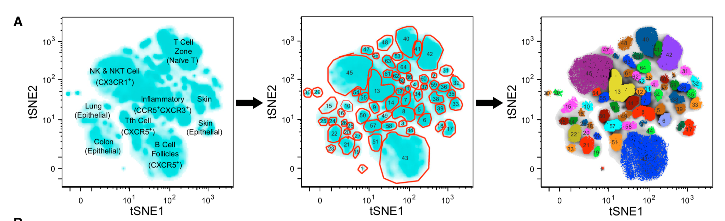
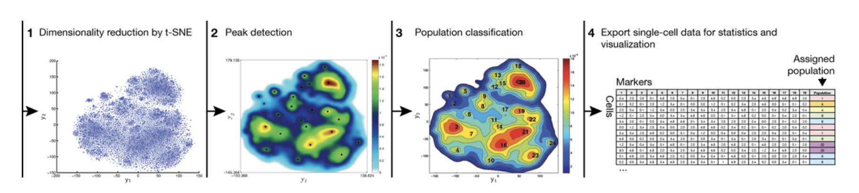
People are already gating and clustering t-SNE maps! Is this ok??
Michael Wong and Evan Newell: Manually gating a t-SNE map
Wong et al,
Cell 2016
Accense (Petter Brodin): Clustering a t-SNE map
Shekar et al,
PNAS 2014
Notes:
This is an urgent question because there are a growing number of people out there who are manually gating t-SNE maps, like Evan Newell, or clustering t-SNE maps, like Petter Brodin. Of note, the following slides will not discount any of their work. I have lots of respect for these two groups. Rather, it will provide guidelines for future studies regarding how to see if a t-SNE gate is meaningful.

Slide 18
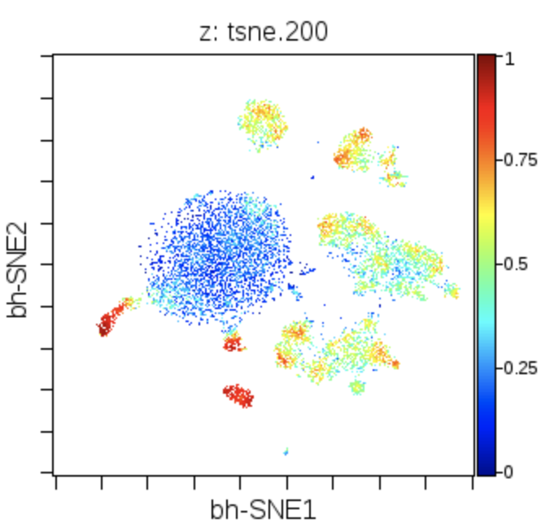
Method: color t-SNE map by KNN fidelity for a given set of values K
Local
Structure
Global
Structure
Notes:
The plot I showed you previously is the AVERAGE per-cell KNN similarity between high-dimensional space and t-SNE space. What I’m going to show you now is the t-SNE map colored by ITS OWN fidelity. This allows us to ask if the t-SNE algorithm gives more fidelity to particular regions. The map on the right is a little spoiler alert.

Slide 19
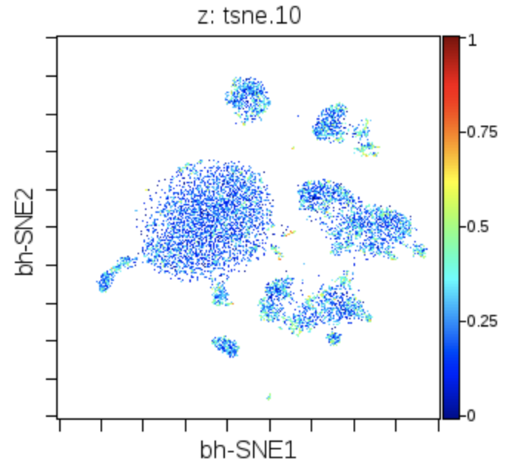
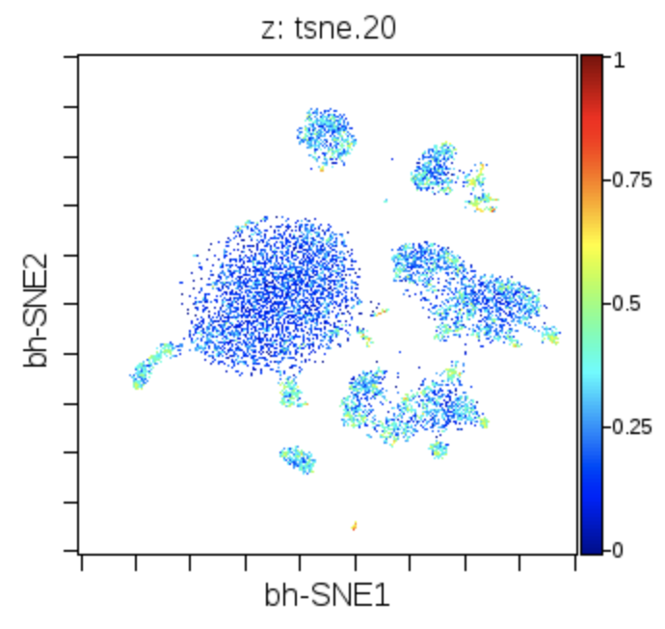
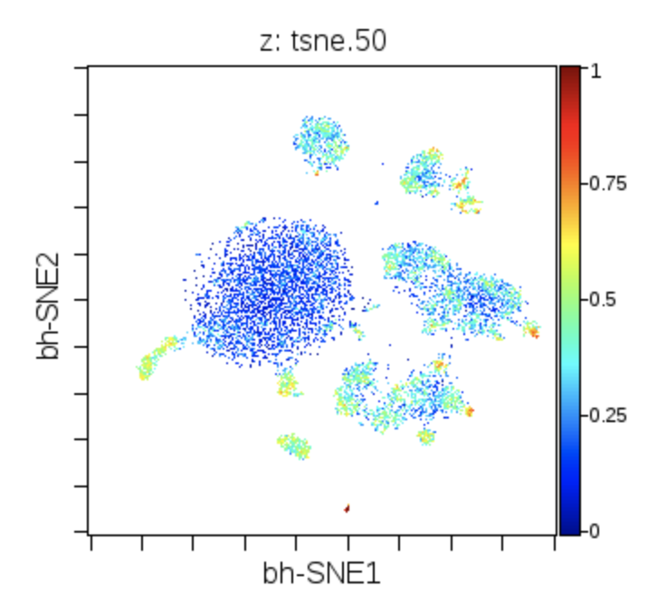
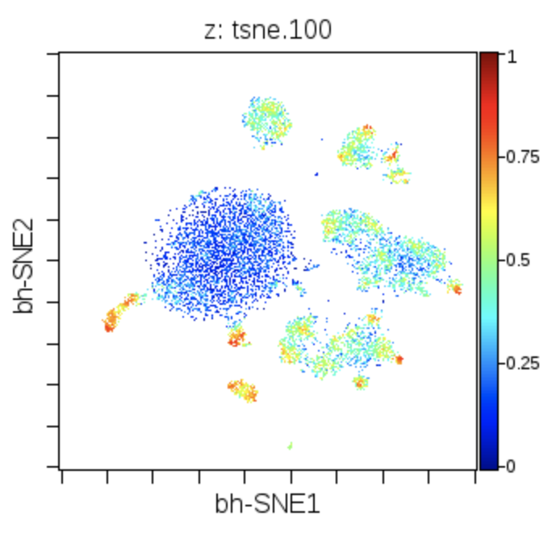
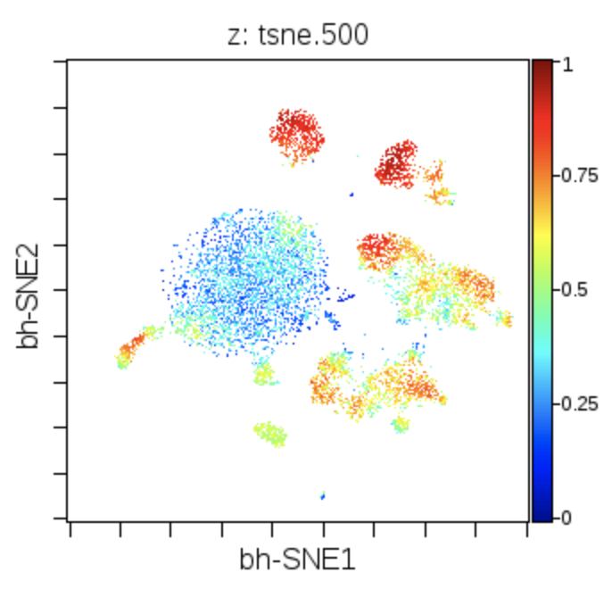
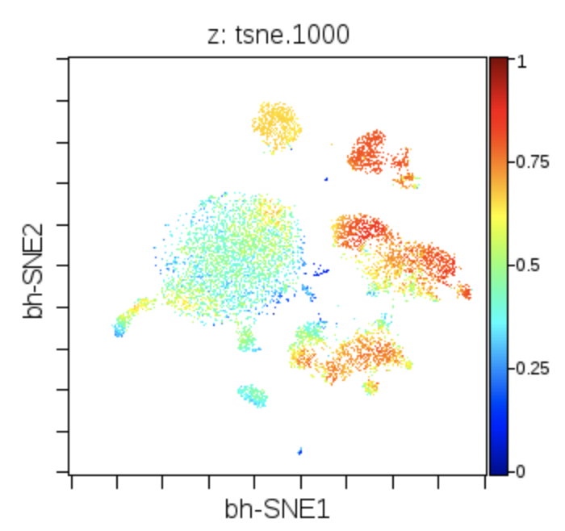
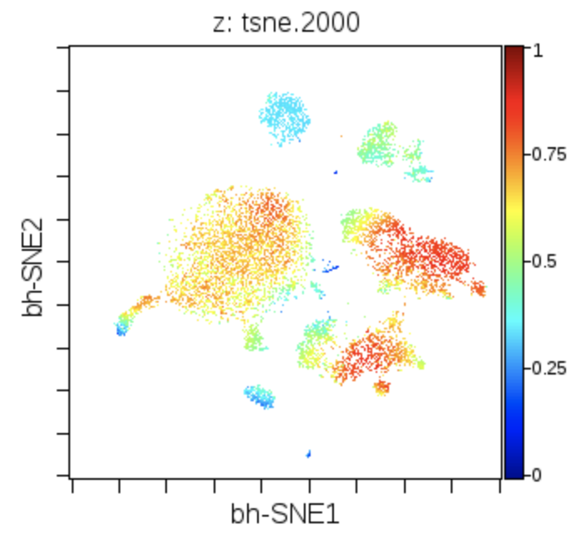
Local t-SNE fidelity sets guidelines for t-SNE clustering and gating
Notes:
Here you see the maps colored by KNN fidelity with increasing sizes of the per-cell nearest neighborhoods. The color is the proportion of shared KNN between 0 and 1. As you can see as we increase the size of the nearest neighborhoods, the fidelity of very particular regions approach 1 much faster than others. The large blob is the CD14 monocytes, defined largely by that marker. Some of these smaller blobs over here are t-SNE subset, defined by several markers.
Now there’s a lot of information here, but together it can tell you how much attention t-SNE paid to the fidelity of particular regions. It means that breaking this CD14 population into more than one gate is probably meaningless, whereas gating these small regions of high fidelity are probably biologically meaningful. If you’re clustering a t-SNE map, these images can give you an idea of what clusters should be merged and how many clusters you should have.
The disclaimer here is that I’m not a fan of gating and clustering the t-SNE map. But plenty of people are, and visuals like this should be your guide accordingly.

Slide 20


Future directions
Make a BioConductor package that allows people to make these visualizations on their particular data type, or manifold embedding algorithm of choice
Try this on UMAP and other new dim reduction tools to determine how it handles my data locally and globally

Slide 21

Part 2: Exploring the visual capabilities of large self-organizing maps

Slide 22





U-Matrix visualizations reveal dataset complexity in a manner much different than t-SNE
t-SNE map
10 x 10
(Flow-
SOM
default)
20 x 20
Data type: Mass cytometry
Dims: 42, surface markers
Cell type: PBMCs
Cells: 100,000
50 x 50
100 x 100

Slide 23
Hypothesis: there are regions of the self-organizing map that are not populated
????????
Method:
Color the SOM by number of cells per node (average should be 10).
Threshold by 0 and greater than 0 cells

Slide 24
The majority of the SOM is populated with at least one cell
U-Matrix
Abundance
0-1 Thresholded Abundance
SOM size: 100 x 100
Data type: Mass cytometry
Dims: 42, surface markers
Cell type: PBMCs
Cells: 100,000

Slide 25
Hypothesis: distinct regions of the SOM are defined by distinct markers
Method:
Color the SOM by the marker
expression levels at each node
Compare these types of patterns
to that of a t-SNE map, the “best
practices” visualization scheme for
CyTOF data.
T cells???
CD3
CD4
CD8
Monocytes???
CD14
CD16

Slide 26
Marker expression patterns are concordant with the U-Matrix
U-matrix
CD14
CD16
CD3
CD4
CD8
CD11c
CD7
CD56
CD20

Slide 27





SOM vs t-SNE: colors of marker expression
CD14
CD16
CD4
CD8
IgA

Slide 28


Hypothesis: U-matrix patterns could be brought out by analyzing Chebyshev distance between nodes
U-matrix
CD14
CD16
I don’t see this boundary
in the U-matrix!!
Method 1:
Calculate U-matrix with
Chebyshev
distance
Method 2:
Use the max
not the mean
of all distances in the Moore neighborhood

Slide 29
U-matrix visualization with alternate distance and neighbor aggregation functions
Euclidean mean
Euclidean max
Chebyshev mean
Chebyshev max

Slide 30
Hypothesis: Meta-clustering will draw boundaries in concordance with the U-matrix
Cluster 1
Method:
Perform hierarchical clustering on the
SOM nodes based on their marker expression
2) Visualize the meta-clusters on the map
itself to compare with the U-matrix
Cluster 2
Cluster 3
…

Slide 31
Color of U-Matrix by identity of the meta-clusters
U-matrix
2 clusters
5 clusters
10 clusters
20 clusters
50 clusters
100 clusters
500 clusters

Slide 32

Hypothesis: The Moore neighborhood distance averages provides similar information to the KNN distance averages

Slide 33
U-Matrix versus KNN-density estimation for SOM
U-matrix
k = 1
k = 10
k = 50
k = 100
k = 200
k = 500
k = 1000

Slide 34
Hypothesis: U-matrix positioning fidelity more closely approximates the manifold locally than t-SNE positioning
High
fidelity???
Method:
Perform KNN
with K = 8 on
marker expression
per-node
Compare KNN
ID with the Moore
Neighborhood ID
Low
fidelity
Low
fidelity???
High fidelity

Slide 35
U-matrix fidelity: detecting topology of the SOM
Similarity of Outer Moore Neighborhood vs
KNN with K of 8
U-matrix

Slide 36

Hypothesis: Emergent self-organizing map (more nodes than number of cells) will provide helpful visualization for users
Method:
Train a 1000 x 1000
SOM on 10,000 cells.
This makes 100 nodes for
every cell.
(Runtime: 5 hours!)
2) Visualize the U-matrix,
and cell occupancy

Slide 37


U-matrix and cell abundance profile of ESOM…still needs to be optimized
U-matrix
Abundance

Slide 38




2001: A Marker Space Odyssey

Slide 39


Future directions
Explore the use of U-Matrix visualizations on trajectory-based datasets
Compare the results I have with that of a growing neural gas, or hierarchical SOM

Slide 40

Notes:
And with that, here are my acknowledgements, with especially a huge thanks to Henrik for helping me make the big transition from the USA to Germany. It’s been a long road, but it has REALLY been worth it.

